Slide 1
Model View View-Model Pattern
Remon Kamel | @harryremon

Slide 2
Course Topics
XAML Deep Dive for Windows & Windows Phone Apps Jump Start
01 | Intro to XAML
02 | XAML UI Elements
03 | Controls
04 | Panels & Layout
05 | Data Binding
06 | MVVM
07 | Windows Personality Controls

Slide 3
Module 6 | MVVM

Slide 4
the mvvm pattern

Slide 5
From MVC
Model
View
Controller

Slide 6
To MVVM
Model
Databinding
View
Databinding
Presentation Model
(ViewModel)

Slide 7
The relationships
View
DataBinding
Commands
Services
Messages
ViewModel
Model

Slide 8
Commands
“Point of entry” for a method
Can be data bound
ICommand interface
Execute method
CanExecute method
CanExecuteChanged event

Slide 9
Implementing commands
It’s quite a lot of work
Most toolkits and frameworks have a “relay” implementation
RelayCommand (MVVM Light)
DelegateCommand (PRISM)
…

Slide 10

MVVM demo

Slide 11



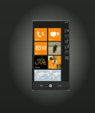
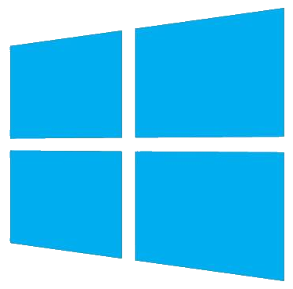
MVVM Light Toolkit
“Breaking the monotony”
http://www.galasoft.ch/mvvm/
http://mvvmlight.codeplex.com
Keep it small
Keep it simple

Slide 12
MVVM Light Toolkit
RelayCommand
Messenger
ViewModelBase
DispatcherHelper
SimpleIoc
EventToCommand
Project templates
Item templates
Code snippets

